Slide 1

Weather Type Classification: A Machine Learning Approach
Understanding and classifying weather conditions is crucial for various sectors, including agriculture, transportation, tourism, and disaster preparedness. This project simulates a real-world scenario using a synthetic dataset to classify weather into types like Rainy, Sunny, Cloudy, or Snowy.
Baratam Snehith

Slide 2
Project Objective & Dataset Overview
Objective
Dataset Features
To build a machine learning model that accurately classifies weather types (Rainy, Sunny, Cloudy, Snowy) based on environmental and atmospheric features.
Temperature (Float): Air temperature in Celsius.
Humidity (Float): Relative humidity percentage.
Wind Speed (Float): Wind speed in km/h.
Target Variable
Precipitation (%): Amount of precipitation.
The 'Weather Type' column, which includes 'Rainy', 'Sunny', 'Cloudy', and 'Snowy' categories.
Cloud Cover (Categorical): Description of cloud coverage.
Atmospheric Pressure (Float): Pressure in hPa.
UV Index (Float): Ultraviolet radiation level.
Season (Categorical): Season data was recorded.
Visibility (km): Distance visible in kilometers.
Location (Categorical): Type of location.

Slide 3
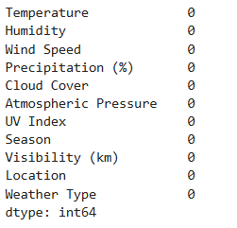
Data Inspection: Initial Insights
Missing Values:-​
Dataset Dimensions
Missing Values & Duplicates
The dataset contains 13,200 rows and 11 columns, with each row representing a unique weather observation.
No null values or duplicate rows were found, indicating a clean dataset ready for analysis.
Target Balance
The 'Weather Type' column is perfectly balanced, with 3,300 records for each of the four classes: Rainy, Cloudy, Sunny, and Snowy. This prevents bias in model training.

Slide 4
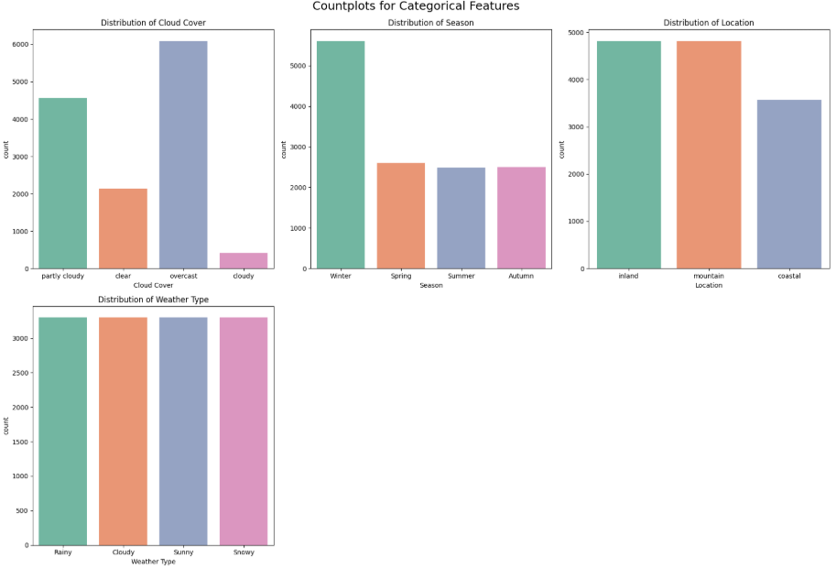
Univariate Analysis :-
Univariate Analysis – Categorical Columns
Cloud Cover:
Overcast conditions are the most dominant, followed by partly cloudy and clear skies.
Cloudy (non-overcast) conditions are rare in the dataset.
Indicates frequent overcast skies, which may impact sunlight-dependent weather behaviors.
Season:
Winter is the most represented season in the dataset.
Spring, Summer, and Autumn occur at similar but lower frequencies.
Suggests potential seasonal bias in predictions skewed toward winter scenarios.
Location:
Inland and Mountain regions have the highest number of observations.
Coastal data is less represented.
Model may generalize better for inland and mountainous conditions than coastal ones.
Weather Type (Target Variable):
All four weather types—Rainy, Cloudy, Sunny, and Snowy—are nearly equally distributed.
This balanced distribution supports effective and fair training for multiclass classification.

Slide 5
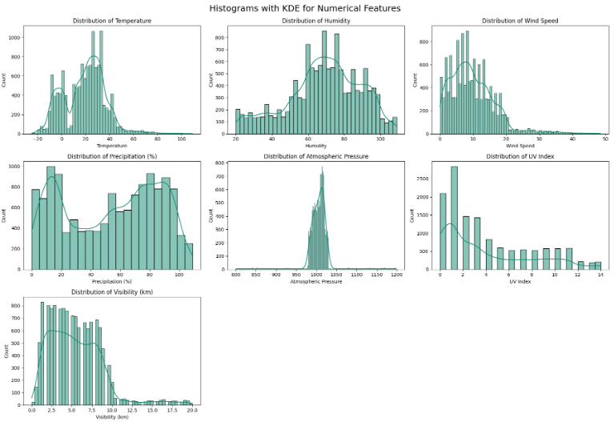
Univariate Analysis :-
Univariate Analysis – Numerical Features (Histogram + KDE)
1. Temperature
Distribution is multimodal with peaks around 0°C and 25°C.
Data ranges widely from -20°C to 80°C.
Indicates a diverse set of climatic conditions in the dataset.
2. Humidity
Appears normally distributed, centered around 60–70%.
Well-balanced spread across the dataset.
Represents typical atmospheric moisture levels.
3. Wind Speed
Right-skewed distribution with most values between 0–15 km/h.
High wind speed values are rare.
Useful for identifying calm vs windy conditions.
4. Precipitation (%)
Bimodal distribution with peaks near 0% and 100%.
Reflects that conditions are either mostly dry or heavily wet.
Important for distinguishing between extreme and normal rainfall.
5. Atmospheric Pressure
Very narrow normal distribution centered around 1000 hPa.
Low variability across observations.
Useful in detecting weather anomalies like storms or depressions.
6. UV Index
Highly right-skewed with most values concentrated under 5.
Very few cases with extremely high UV index.
Critical for determining exposure risk.
7. Visibility (km)
Positively skewed distribution with most values under 10 km.
Fewer observations at high visibility levels.
Suggests frequent foggy, rainy, or polluted conditions.

Slide 6
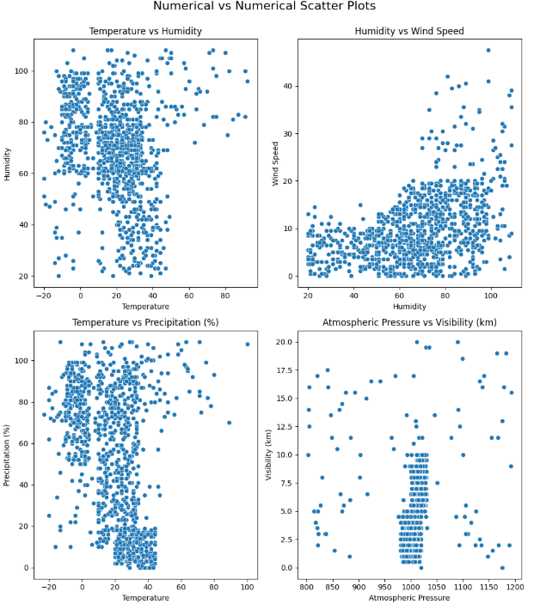
Bivariate Analysis :-
Bivariate Analysis – Numerical Features
Temperature vs Humidity
Data points are densely clustered between 0–30°C.
No clear linear relationship; humidity remains high across all temperature ranges.
Indicates temperature doesn't strongly predict humidity in this dataset.
Humidity vs Wind Speed
Wind speed generally increases with higher humidity but remains mostly below 20 km/h.
Slight positive trend at higher humidity values.
Suggests some association, but variability is high.
Temperature vs Precipitation (%)
Higher precipitation often occurs at lower temperatures (especially <20°C).
Two clusters observed: high precipitation and low precipitation groups.
May reflect different seasonal behaviors or storm patterns.
Atmospheric Pressure vs Visibility (km)
Visibility is mostly constant across a narrow range of pressures (around 1000 hPa).
Sparse data at low and high pressure values.
No strong visible trend; might need advanced techniques (correlation heatmap, modeling) to explore influence.

Slide 7
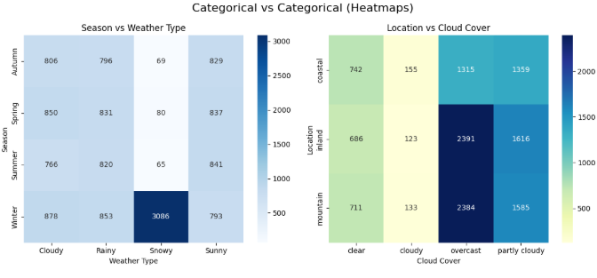
Bivariate Analysis :-
Bivariate Analysis – Categorical Features
1. Season vs Weather Type
Winter–Snowy has a significantly high count (3086), dominating all other combinations.
Sunny weather is fairly consistent across all seasons.
Rainy and Cloudy weather are relatively balanced in all seasons.
Insight: Snow is highly concentrated in winter, making it a strong seasonal-weather relationship.
2. Location vs Cloud Cover
Overcast skies are most common in inland and mountain regions.
Partly Cloudy is also frequent across all locations, especially in mountain areas.
Clear and Cloudy (non-overcast) skies are less frequent in all locations.
Insight: Overcast conditions dominate inland and mountain locations, possibly due to elevation and regional climate factors.

Slide 8
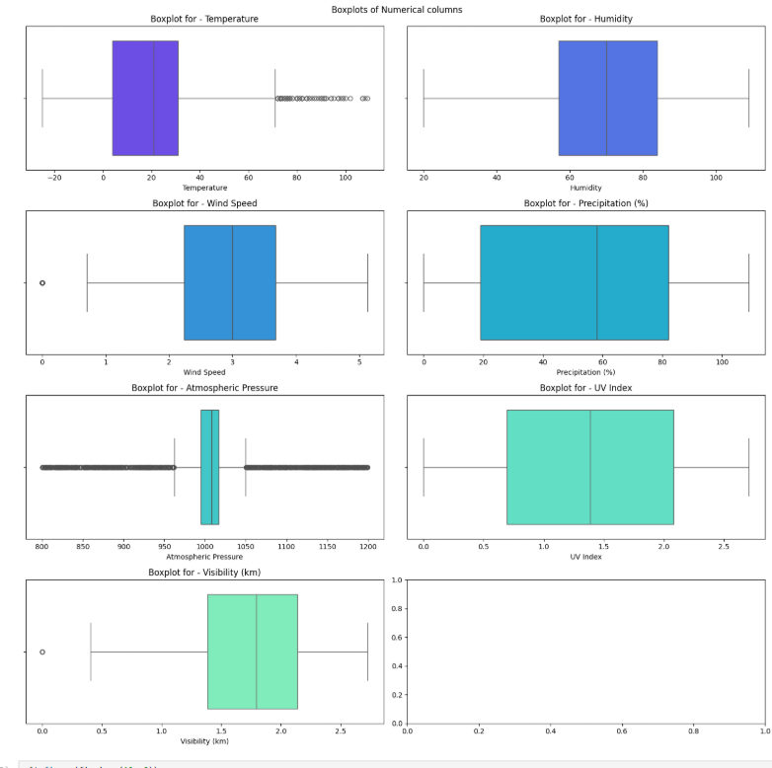
Outlier Detection & Handling
Skewness & Outlier Handling Summary
Step 1: Outlier Detection
Used both IQR and Standard Deviation methods.
Chose IQR method for clipping outliers in Wind Speed, UV Index,
and Visibility (km).
Step 2: Skewness Before Clipping
Wind Speed: 1.36 → Highly right-skewed.
UV Index: 0.90 → Moderately right-skewed.
Visibility (km): 1.23 → Highly right-skewed.
Step 3: After IQR-Based Clipping
Wind Speed: 0.68
Visibility (km): 0.72
Outliers reduced, but still moderate skewness.
Step 4: Applied Feature Transformations
Wind Speed: Square Root Transformation → Final skewness: -0.23
UV Index: Log1p Transformation → Final skewness: -0.05
Visibility (km): Log1p Transformation → Final skewness: -0.39

Slide 9
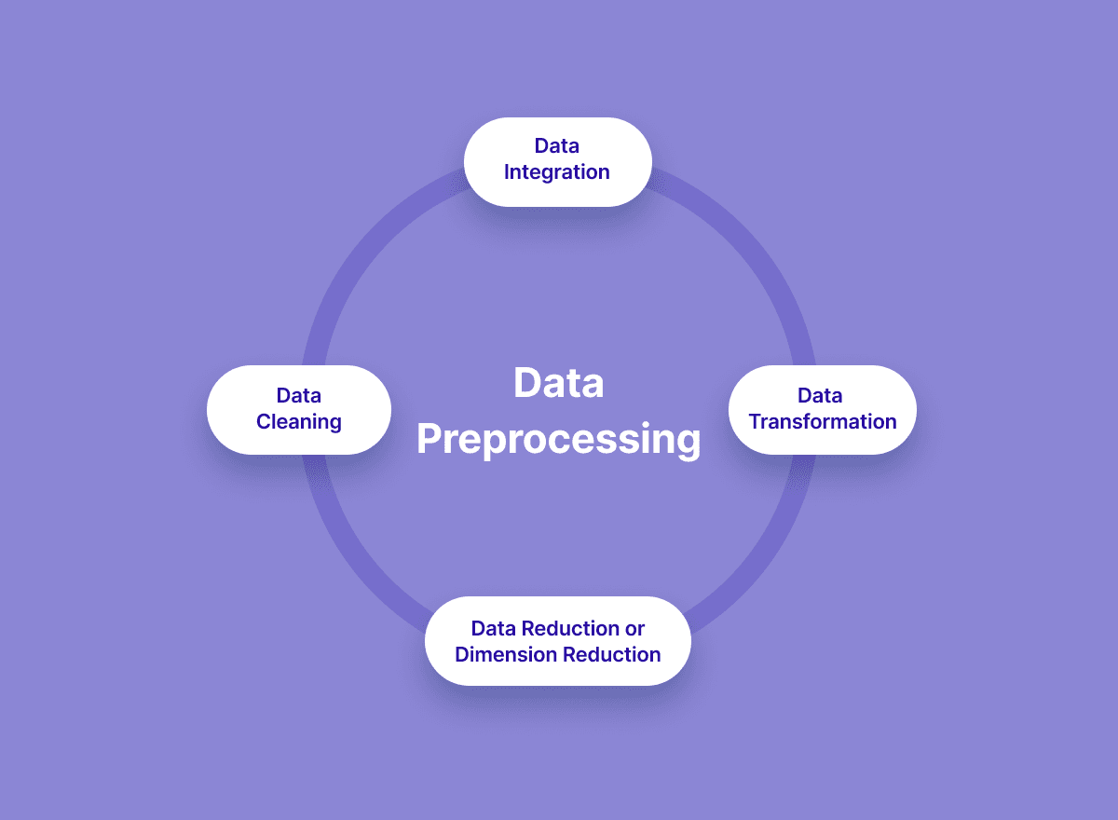
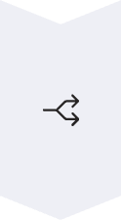


Data Preprocessing Steps
Data Splitting
The dataset was split into training (80%) and testing (20%) sets (X_train, X_test, y_train, y_test) with stratification to maintain class balance.
Categorical Encoding
'Season' and 'Location' were One-Hot Encoded, while 'Cloud Cover' was also One-Hot Encoded. The target variable 'Weather Type' was Label Encoded.
Feature Scaling
Numerical features were scaled using StandardScaler to ensure uniform contribution to the model.

Slide 10
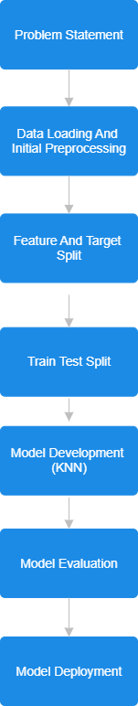
Workflow of my model

Slide 11
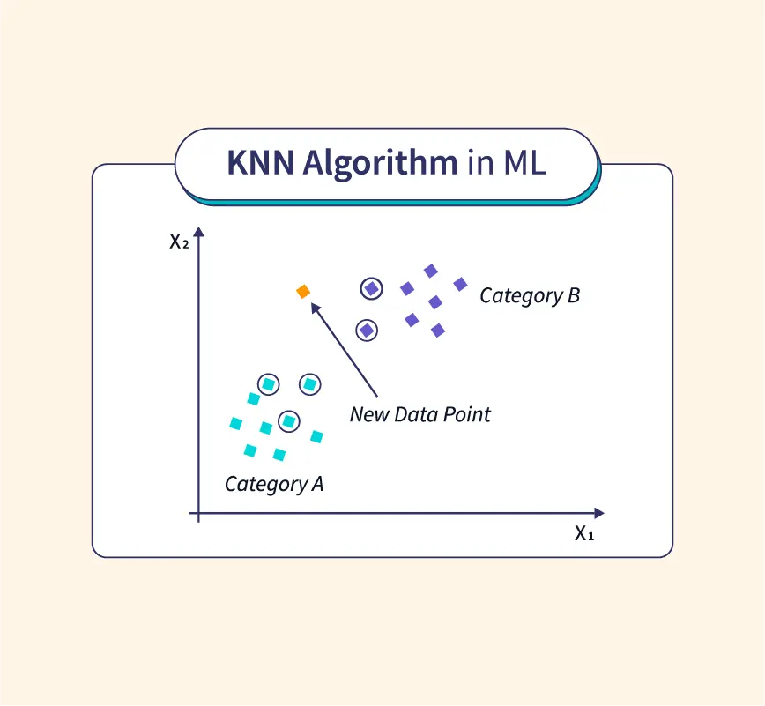
Model Training: K-Nearest Neighbors (KNN)
1
Model Selection
K-Nearest Neighbors (KNN) was chosen as the classification model for its simplicity and effectiveness in multi-class problems.
2
Hyperparameter Tuning
Optuna's GridSampler was used to tune hyperparameters, specifically 'k' (number of neighbors) and 'weights' ('uniform' or 'distance'), with 3-fold cross-validation.
3
Best Parameters
The best hyperparameters found were k=31 and weights='distance', achieving a cross-validation accuracy of 0.884375.

Slide 12
Model Evaluation: Performance Metrics
Metric | Value / Result | Simple Insight
Accuracy | 88.9% | Model predicts well overall
Precision | Cloudy: 0.83, Rainy: 0.86, Snowy: 0.93, Sunny: 0.96 | Sunny and Snowy predictions are very accurate
Recall | Cloudy: 0.88, Rainy: 0.89, Snowy: 0.91, Sunny: 0.88 | Most actual labels are correctly found
F1-score | All above 0.85 (Sunny: 0.92) | Good balance between precision and recall
Confusion Matrix | Few mix-ups between similar classes | Misclassifications are reasonable
Dummy Log Loss | 1.386 | Random guessing benchmark
KNN Log Loss | 0.519 | Much better than random; confident predictions
Support per Class | 660 each (stratified split) | Balanced evaluation for all weather types
Probability Quality | Good | Model gives meaningful probability scores
Final Verdict | ✅ Strong multiclass model | Can be used or improved with more tuning/features

Slide 13

Conclusion & Future Steps
Robust Model
The KNN model effectively classifies weather types with high accuracy and balanced performance across all categories, demonstrating its robustness for this task.
Outlier Handling
Effective outlier detection and transformation significantly improved data quality and model performance.
Deployment Ready
All necessary preprocessing objects and the trained model have been serialized for potential deployment in a web application like Streamlit.

